Slide 1
Infoblox Integrations with Cisco ACI
May 7, 2020
Ranga Rao
Director, Solutions Engineering
INSBU, Cisco

Slide 2
Introduction to Infoblox
Industry Leader
6,900+ Customers
83 of Fortune 100 companies
Coverage in all verticals
Extensive portfolio of integrations
Market Share Leader
Notes:
Infoblox is not a start-up. The company was started more than a dozen years ago – our technology is mature and field proven
The company HQ is in the heart of Silicon Valley with global operations in all major geographies –
We do business in 3 regions (Americas, EMEA, APJ)
We have sales, support and development operations in 25 countries and we do business in over 70 countries around the world
Infoblox makes essential technology to control networks – we’ll dig into that a bit later in the
We are a market leader in the space that we serve – with Strong Positive ratings from Gartner (3 years in a row) and 40% market share
(Note: Gartner Market Scope and market share stat is specific to DDI)
Infoblox has a massive customer base – our latest count is 6,900 different companies- we have shipped 64,000 systems
We are innovative, with a formal patent program for our employees. As of right now we own 32 patents and 25 more pending
Last but not least – the company did a successful IPO in April 2012. We now share our financial results publicly – which can be seen on the right.

Slide 3


Wide Array of Integrations with Cisco
Security
SDN
Automation
Visibility into DNS security and network events, timely response and improved situational awareness
Visibility, security and policy enforcement in SDN environments
Automatic network configurations and policy enforcement
Infoblox DDI and ActiveTrust ® integration with Cisco ISE
Infoblox ActiveTrust® TIDE on Cisco Threat Intelligence Director
Infoblox DDI Integration with Cisco ACI
Infoblox DDI Integration with Cisco ACI via OpenStack
Infoblox Network Insight integration with Cisco ACI
Infoblox NetMRI integration with Cisco ACI
Infoblox integration with Cisco Digital Network Architecture (Cisco DNA)
Infoblox integration with Cisco Tetration
Infoblox integration with Cisco CliQr (now called Cloud Center)
Notes:
Infoblox is different from existing solutions and alternatives because it allows you to implement the best practices that separate top tier companies from their peers. This combination of best practices is
The ability to automate basic tasks: Infoblox intelligently serves DNS protocol, allows you to centrally manage your infrastructure and automate basic network task and integrate with your existing workflow to maximize efficiency.
The ability to bridge silos with an extensible framework of APIs that allow you to share intelligence with your infrastructure and automation action and remediation by integrating with your workflow systems and security infrastructure.
The ability to provide proactive intelligence posture – by providing business and network context, or the when, where, who and what for security and compliance.
The ability to manage the entire infrastructure in a unified fashion, whether it is a legacy infrastructure, a virtualized environment, a private cloud, or a public cloud environment, or any combination of the above.
Making DNS data accessible so organizations can get a single pane of glass visibility across the entire infrastructure, and have access to the data and context required to take action or conduct analysis for investigation.

Slide 4
Infoblox - ACI Integrations

Slide 5



Infoblox Integration with Cisco ACI Solution
Enhanced Visibility
Advanced Security
More Automation
FW
LB
Allow *.abcxyz.com
Centralized Visibility in Infoblox
IP address, DNS records for VMs, virtual routers, FW’s, LB’s. etc
DNS Security with ACI Actions
Detect infected endpoints in Infoblox DNS firewall and take remediation actions in ACI like moving an endpoint to a quarantine EPG
DNS Wildcards for Automation
Use DNS names instead of IP addresses for adding endpoints to endpoint groups, load-balancers pools & other network configurations

Slide 6



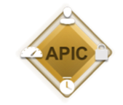

ACI-Infoblox Architecture + Roadmap
Infoblox Grid Master (DDI)
IPAM & Visibility
Synchronization from ACI to Infoblox
View Subnets and VRFs from Infoblox
InfobloxSync
Available Now
ACI AppCenter App
DNS Security
DHCP & Configuration
Ensure DHCP relay is configured correctly
Create DHCP pools in Infoblox from App UI
Move Infoblox-tagged rogue devices to quarantine EPG
(future)
Version 1.1 (April 2017)
Cisco ACI

Slide 7

Architecture: Infoblox App for ACI App-Center
App Center App: InfobloxSync
Extensible Attribute
FRONT END
BACK END
Gather Infoblox IP addr and credentials
Start Flask server
NGINX
Start Infoblox Syncing service
Webtoken & Devcookie
RBAC login to APIC
Extensible Attributes
REST API calls to APIC
AJAX call to backend
HTTPS WAPI POST/PUT
Network Views
Script Logic
Networks
HTTPS WAPI GET
APIC
Management Information Tree
Host Records
Tenant
Subnets
End Point Info
VRF & BD Relation
VMM info

Slide 8
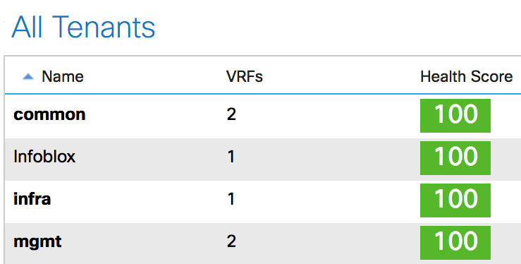
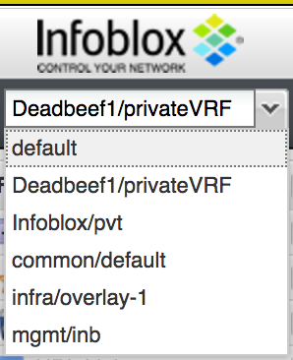
Use Case 1: IPAM & Visibility
ACI: Tenant+VRF
Network Views
Create Infoblox Network Views from Tenants and VRFs
Infoblox: Network Views
Populates BD’s subnets into Infoblox
Subnets can be managed under IPAM
ACI: Subnets

Slide 9
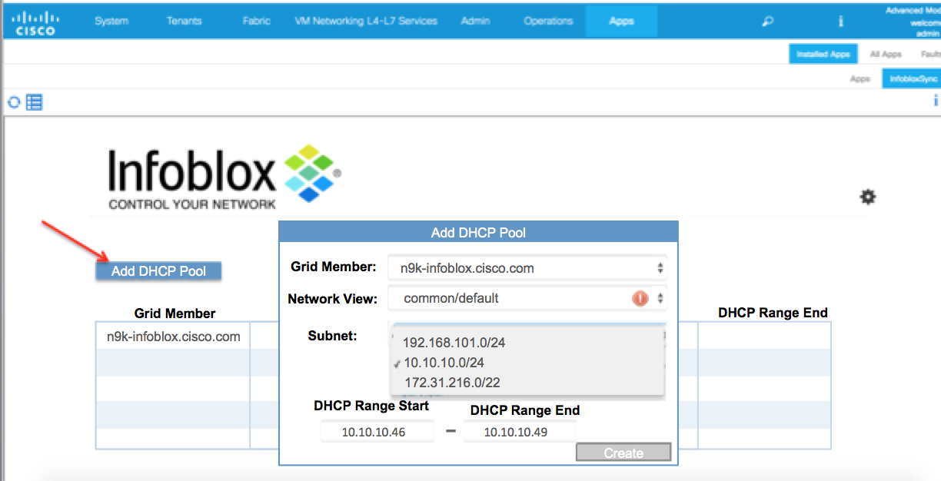
Use Case 2: DHCP Provisioning and Configuration
Create and delete DHCP pools from InfobloxSync app UI
Ensure DHCP relay is configured correctly on APIC
Ensure DHCP service is running on Infoblox Grid Member

Slide 10

Use Case 3: DNS Security
Move Infoblox-Tagged infected or rogue devices to a quarantine EPG
!
Quarantine EPG
DNS-1
DNS-2
Rogue DNS
EPG-1

